Slide 1

Manikya Lal Verma Textile & Eng. College
Q.G. - 11
Submitted To
Mrs. Hareeta Malani
(Project Guide, Asst. ECE Department)
Submitted By
Ashish Sahu
Shubham Sharma
Vishal Yadav
Dharmendra Saini
Santosh Yadav

Slide 2
Advance Security System

Slide 3
Overview
Introduction
Block diagram and flow chart
Simulation
PCB layouts
Implementation

Slide 4
Advance Security System
The aim of our project is to provide privacy and security to a particular Home or companies from remote locations from a central Server system.
the system allows the home owner or company owner to monitor and control the house security like Whose entered, Door lock or door unlocked, which can be switched on or o via the mobile phone set by sending commands in the form of SMS and also the home owner can receive the appliances status.

Slide 5
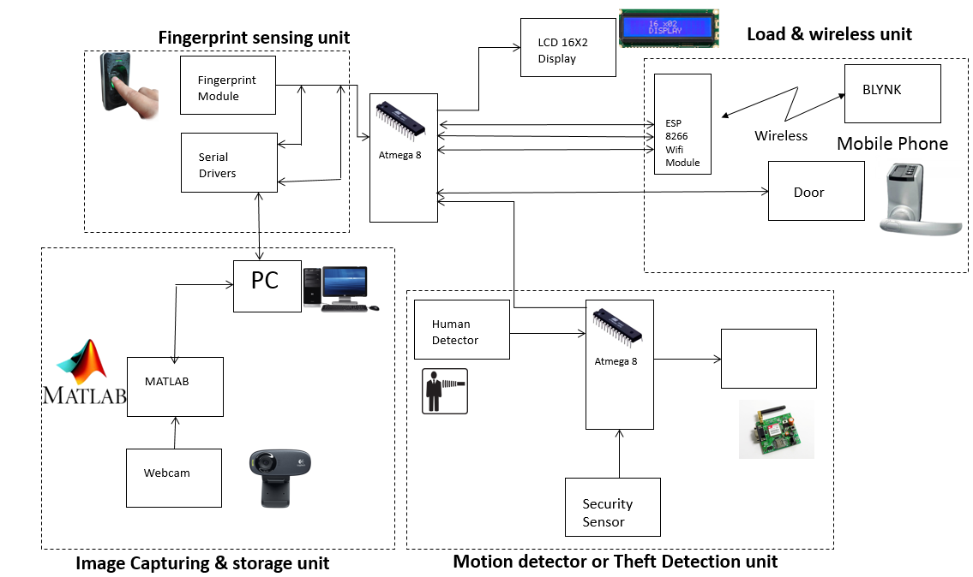
Block Diagram

Slide 6
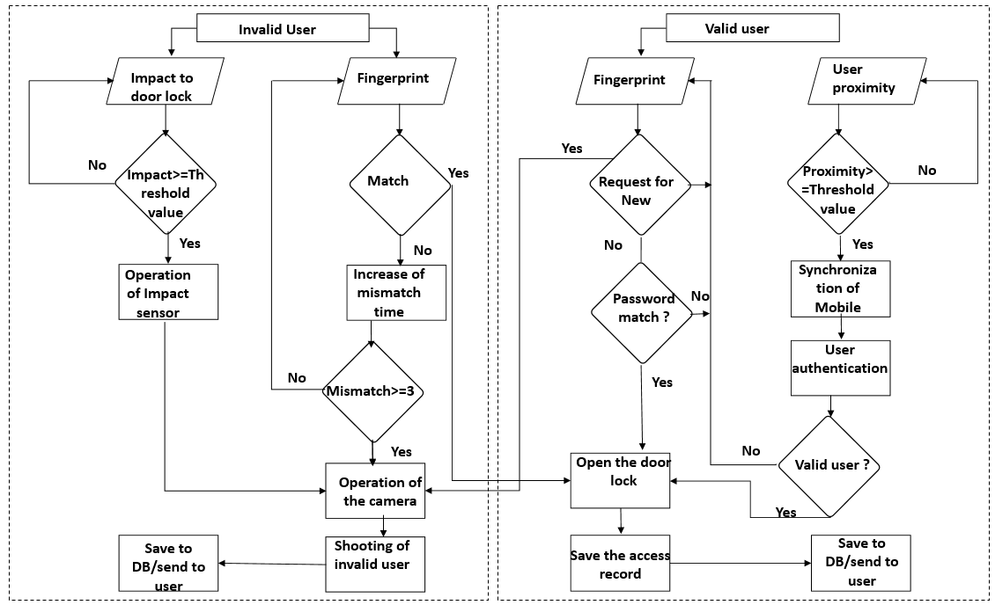
Flow Chart

Slide 7
Algorithm
STEP 1 : START
STEP 2 : FOR each user
STEP 3 : INPUT Action
STEP 4 : SWITCH Action
STEP 5 : CASE “fingerprint”
STEP 6 : IF fingerprint does not match THEN take and send image
STEP 7 : ELSE IF fingerprint is valid THEN open the door
STEP 8 : ELSE IF number of mismatch greater then 3 THEN take and send image
STEP 9 : ELSE go to STEP 2
STEP 10 : CASE “impact”
STEP 11 : Impact Sensor operation
STEP 12 : IF impact value greater then threshold valu THEN camera sensor operation
STEP 13 : ELSE go to STEP 2
STEP 14 : CASE “proximity”
STEP 15 : IF distance greater then threshold value THEN mobile device synchronization
STEP 16 : IF valid user THEN open the door
STEP 17 : ELSE go to STEP 2
STEP 18 : ELSE go to STEP 2
STEP 19 : END

Slide 8
Motion Detector or Theft Detection Unit
The motion sensor gives digital output which has been used as microcontrollers input. When motion has been detected, motion detector gives logical one to the microcontroller.
As a motion sensor we used PIR sensor which allow you to sense motion, almost always used to detect whether a human has moved in or out of the sensor’s range.
They are often referred to as PIR, ”Passive Infrared”, ”Piezoelectric”, or ”IR motion” sensors.

Slide 9
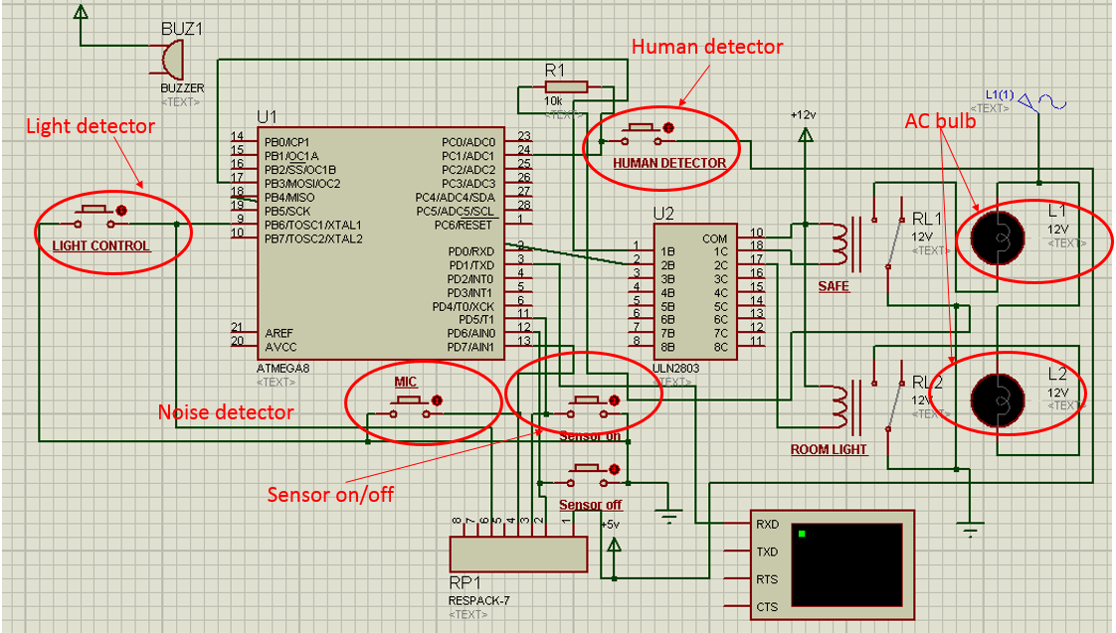
Simulation

Slide 10
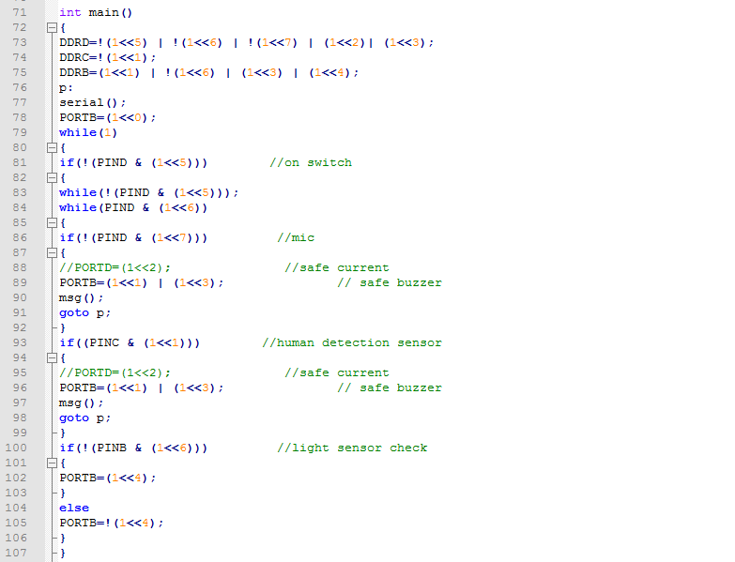
Coding Section

Slide 11
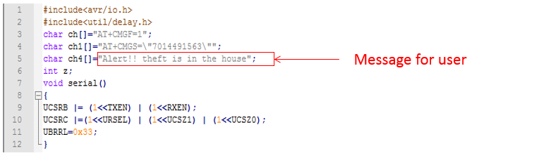
Coding Section for User

Slide 12
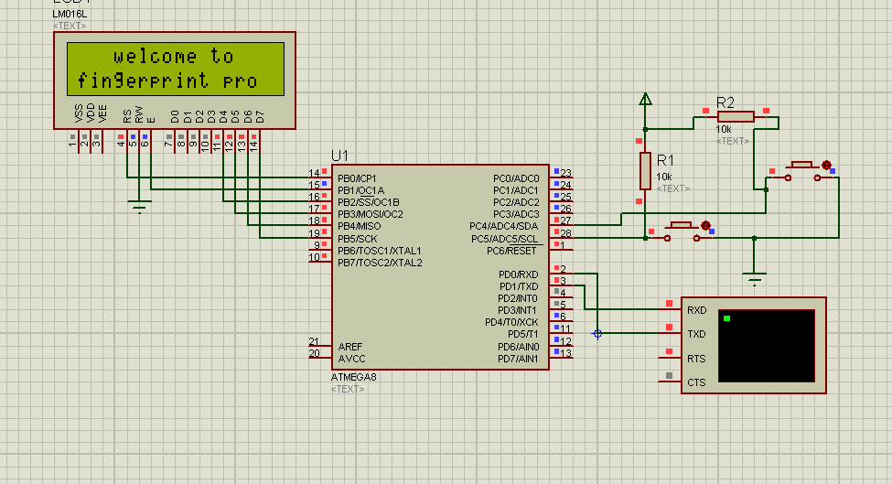
Simulator

Slide 13
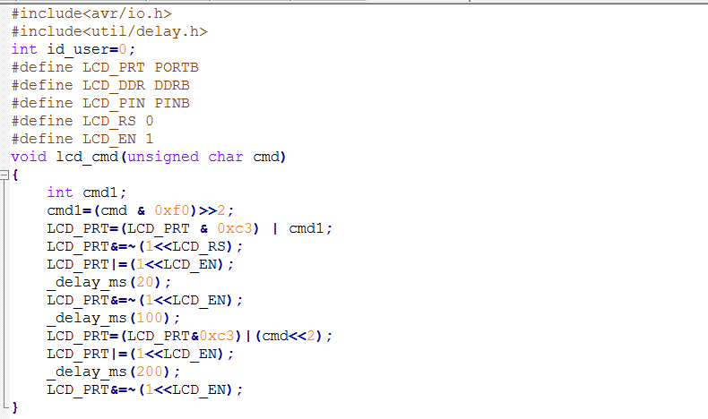
Coding Screenshots of Fingerprint Section
Function for LCD command

Slide 14
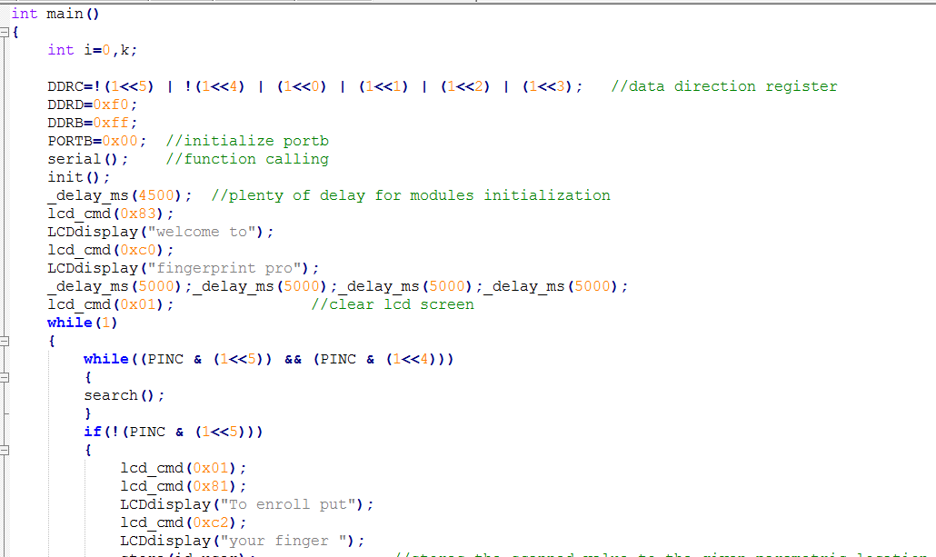
Display message fro LCD
Message for User for enroll

Slide 15
Load and Wireless Unit
Protection of home main door is the important part in security system which done in this system by using electromagnetic lock in conjunction with fingerprint module.
The owner using this biometric for valid user which is display on LCD and if the fingerprint matched is correct then the electromagnetic lock is opened. Otherwise if does not matched, the door will still locked.

Slide 16
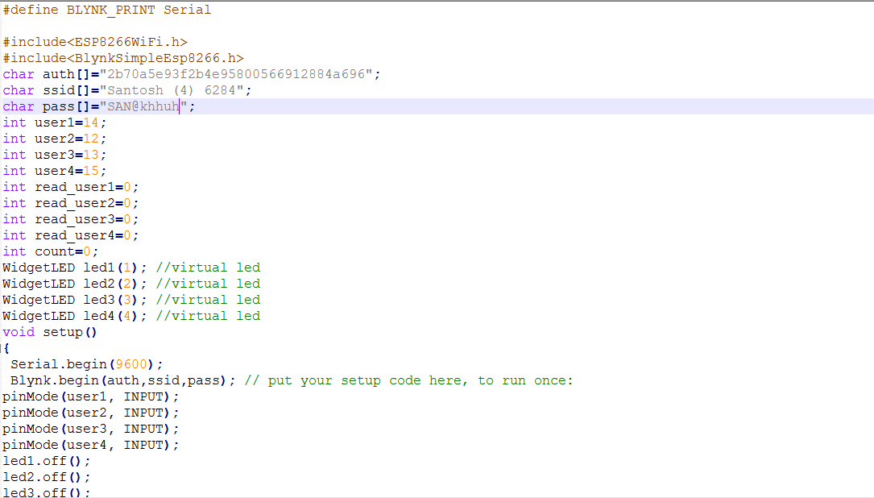
Coding Screenshots of ESP8266 Section
Library and User Authentication

Slide 17
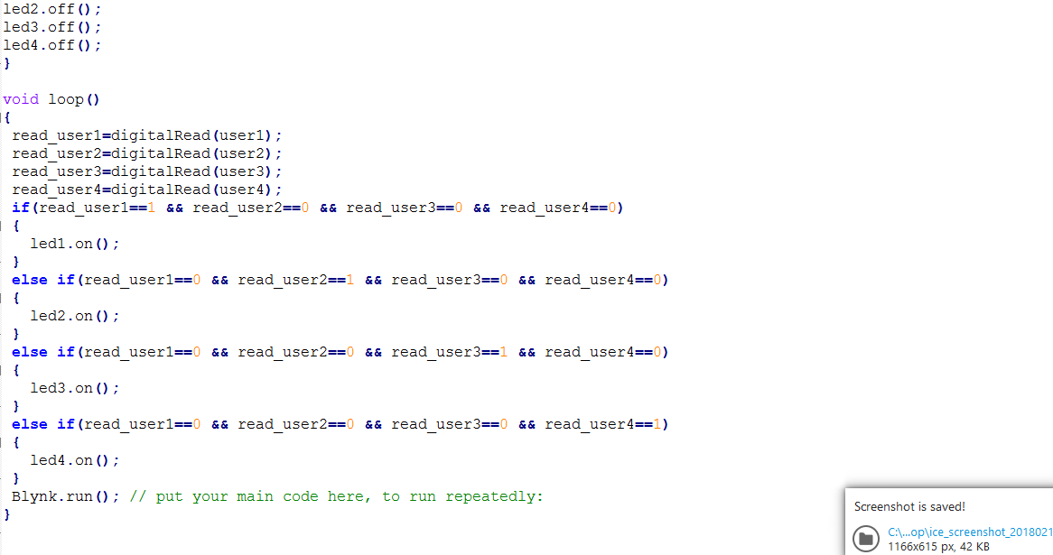

Slide 18
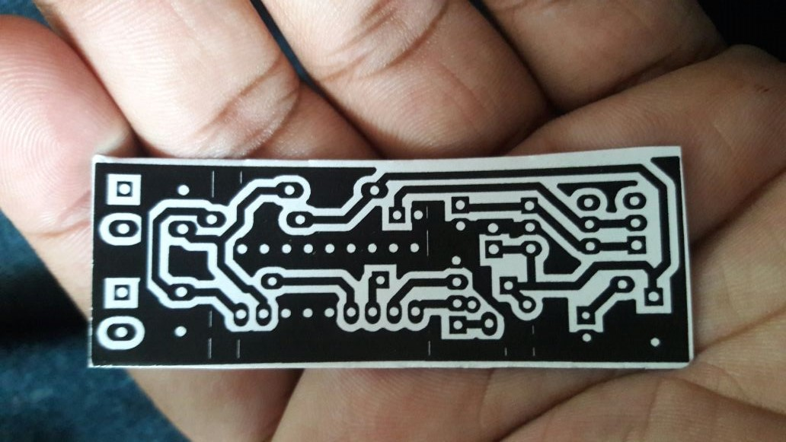
PCB Layout of Transmitter Section

Slide 19
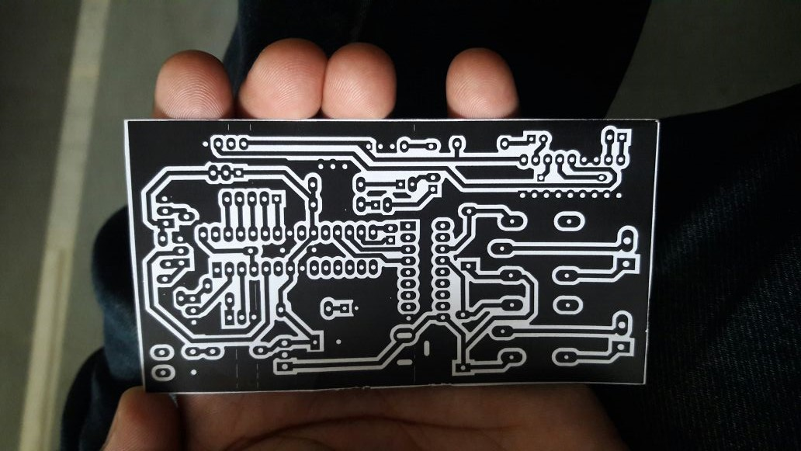
PCB Layout of Atmega 8 Section

Slide 20
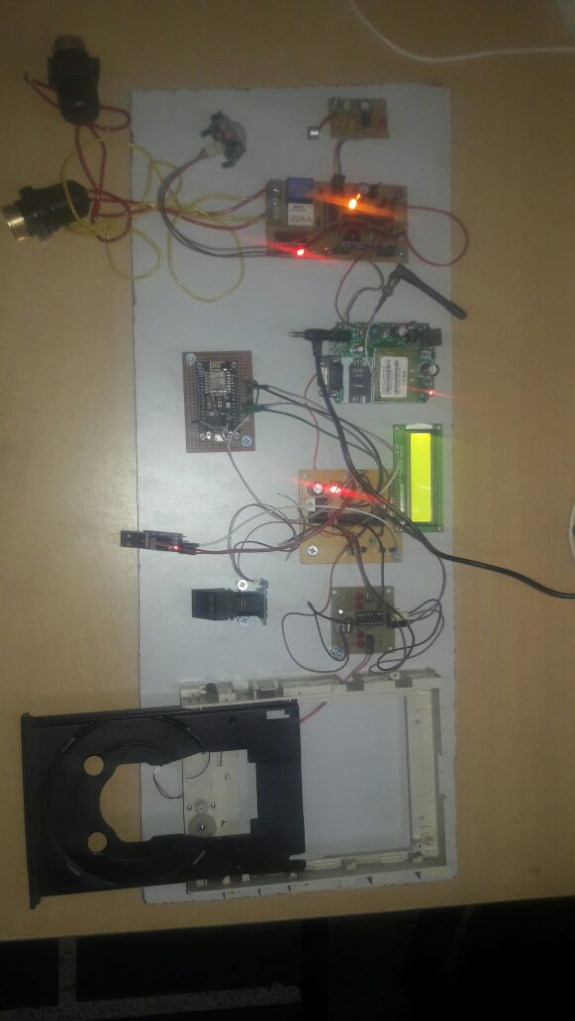
Overall View

Slide 21
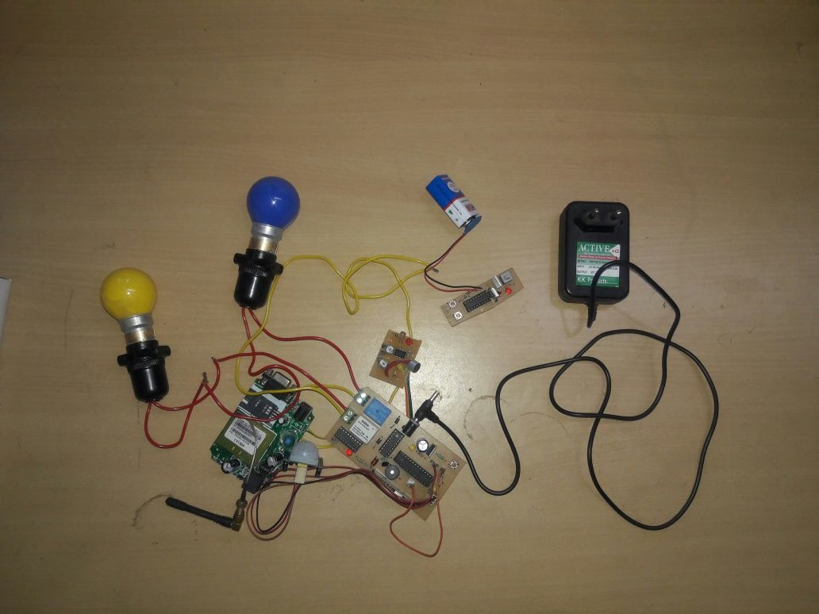
GSM UNIT

Slide 22
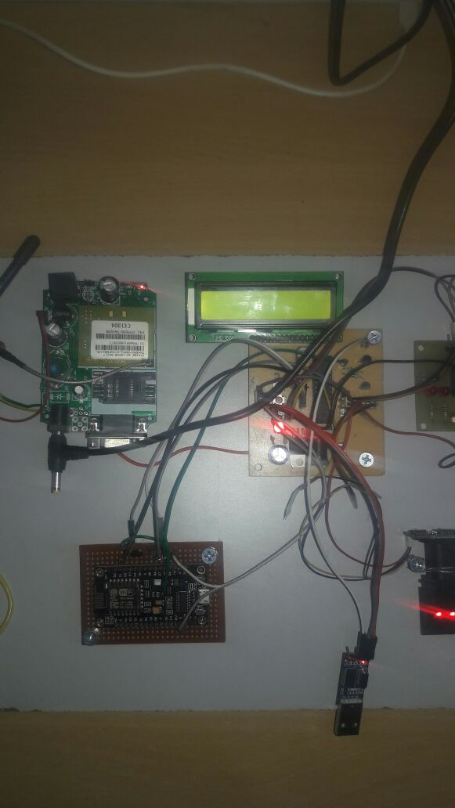
IoT and Main Control Unit

Slide 23
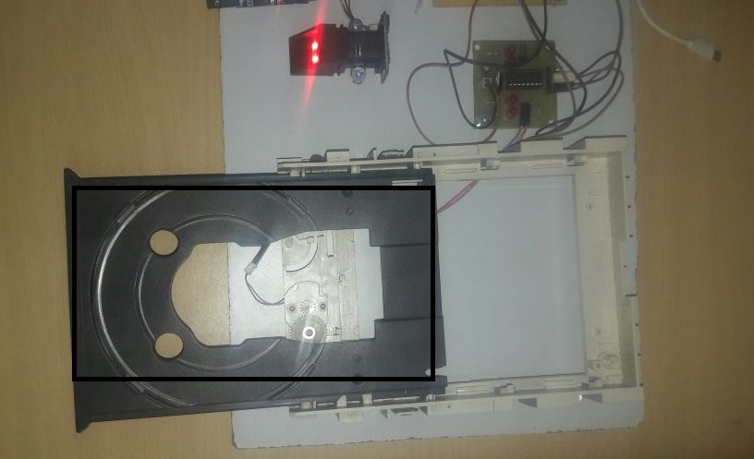
Door Control Section

Slide 24
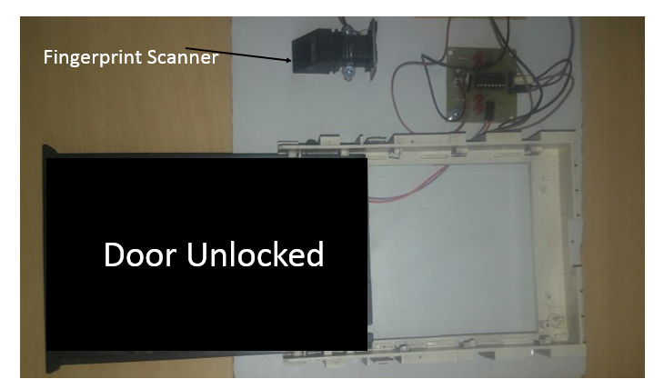

Slide 25
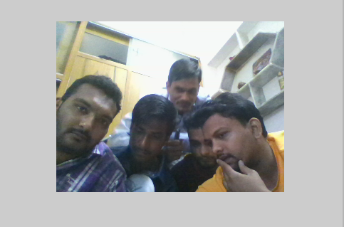
IMAGE IS CAPTURED BY WEBCAM During Invalid User

Slide 26
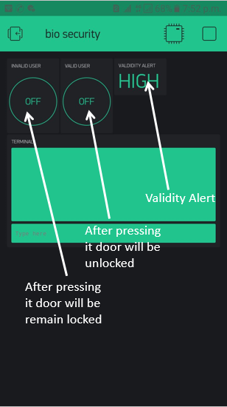
IoT Application Overview

Slide 27
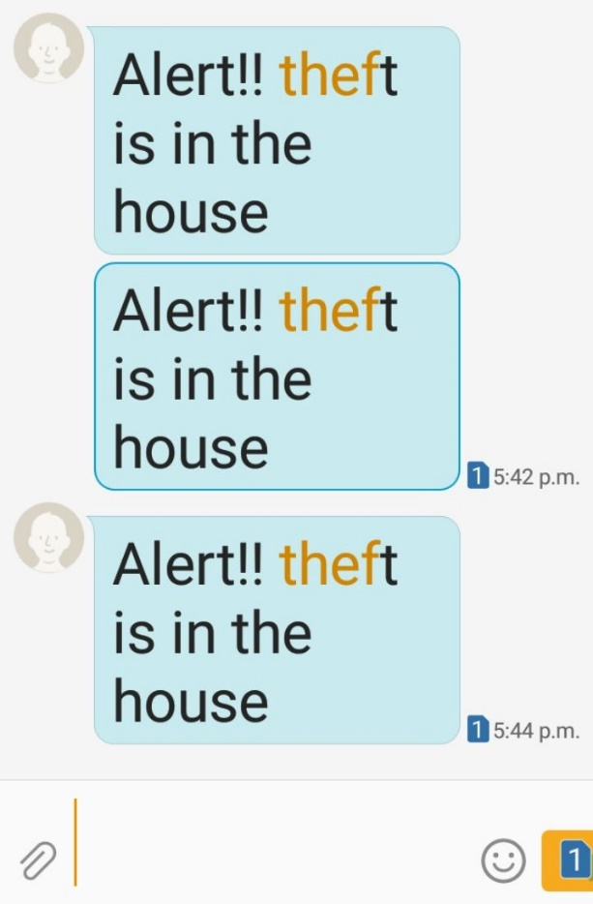
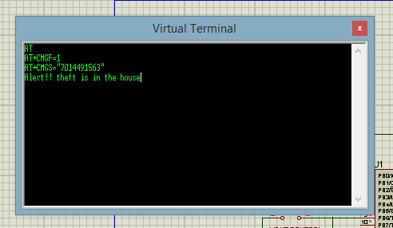
Result
Figure shows the screenshot of the message for the theft detector operation. The user can query all records of comings and goings from the ` Log (Access Record)' menu.

Slide 28
Conclusion
The GSM and IOT based advance security system has been designed and tested with the mobile network.
The user can get alerts anywhere through the GSM technology thus making the system location independent.
The web camera based security system is very easy, user friendly and software has many features.
By installing the web camera at the door site, intruder can be detected and owner can receive a message telling the intruder entry in a home.

Slide 29
References
Yanbo Zhao , Zhaohui Ye "A low cost GSM/GPRS based wireless home security system" IEEE Transactions on Consumer Electronics ( Volume: 54, Issue: 2 ),2008.
C. Pyo, H. Gang, N. Kim and H. Bang, \Technology trends and prospects of development of IoT (M2M)," OSIA Standards & Technology Review, vol. 26, no. 2, (2013), pp. 8-17.
Y. Ko, \Study of Policies of Major Countries on Internet of Things and Market Forecast," In ternational Commerce and Information Review, vol. 16, no. 5, (2014),pp. 27-47.
D. Seo, H. Ko and Y. Noh, \Design and Implementation of Digital Door Lock by IoT," KIISE Transactions on Computing Practices (KTCP), vol. 21, no. 3, (2015), pp. 215-222.

Slide 30
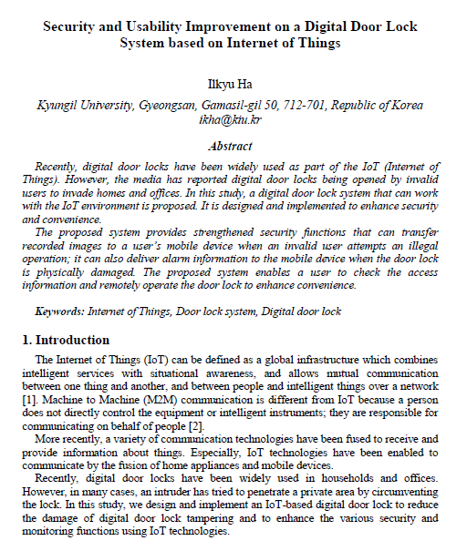

Slide 31
Thank You

